Slide 1
THE EMMAUS HOUSE
RESTORATION
BY THE FEDERATED CHURCH OF ORLEANS

Slide 2
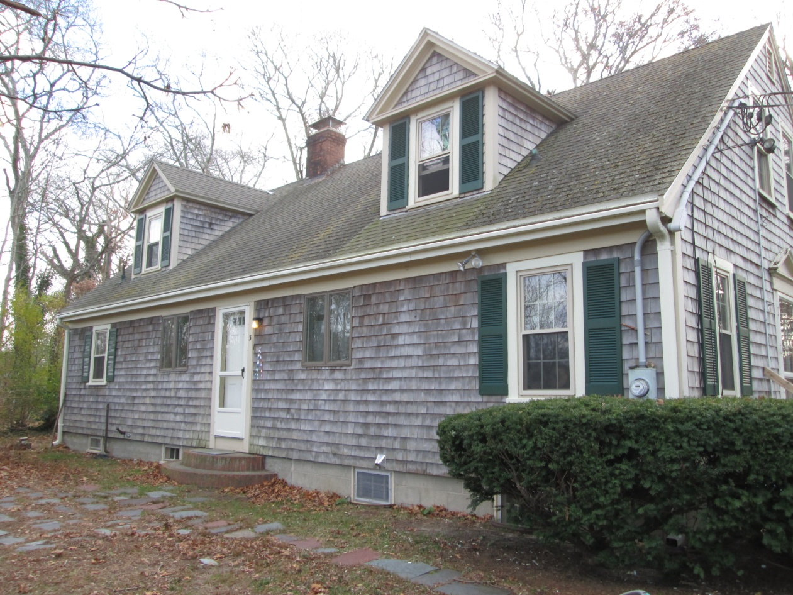
The Emmaus House before the renovation
This house, built in 1938, owned by the Federated Church of Orleans, is used by the State to house six handicapped people to help them recover
This is one of the more important Missions of the Federated Church of Orleans

Slide 3
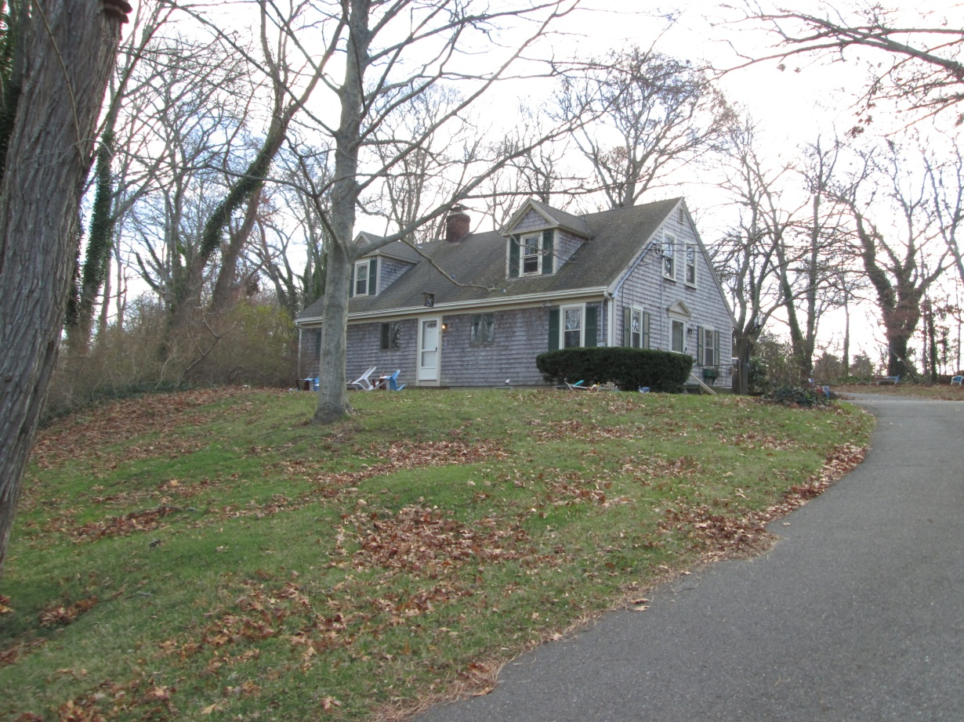
The Emmaus House Renovation
The outside of the house needed complete renovation.

Slide 4
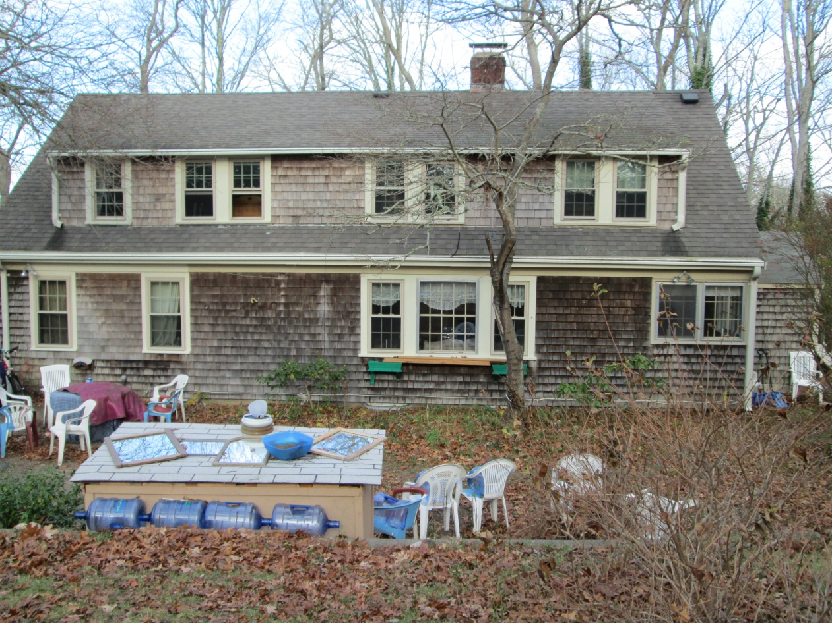
The house needed extensive renovations
The exterior needed new shingles and paint work.

Slide 5
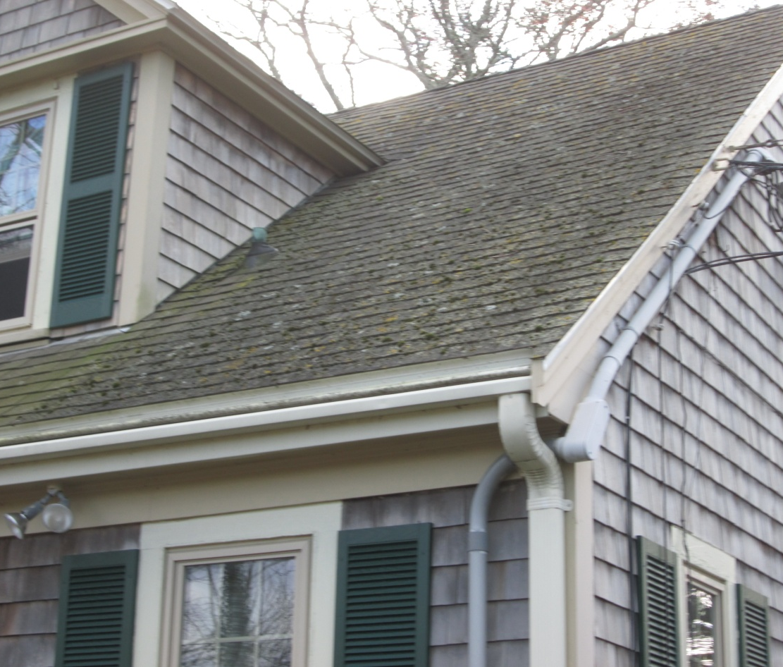
Emmaus House Renovation
Roof shingles had to be replaced

Slide 6
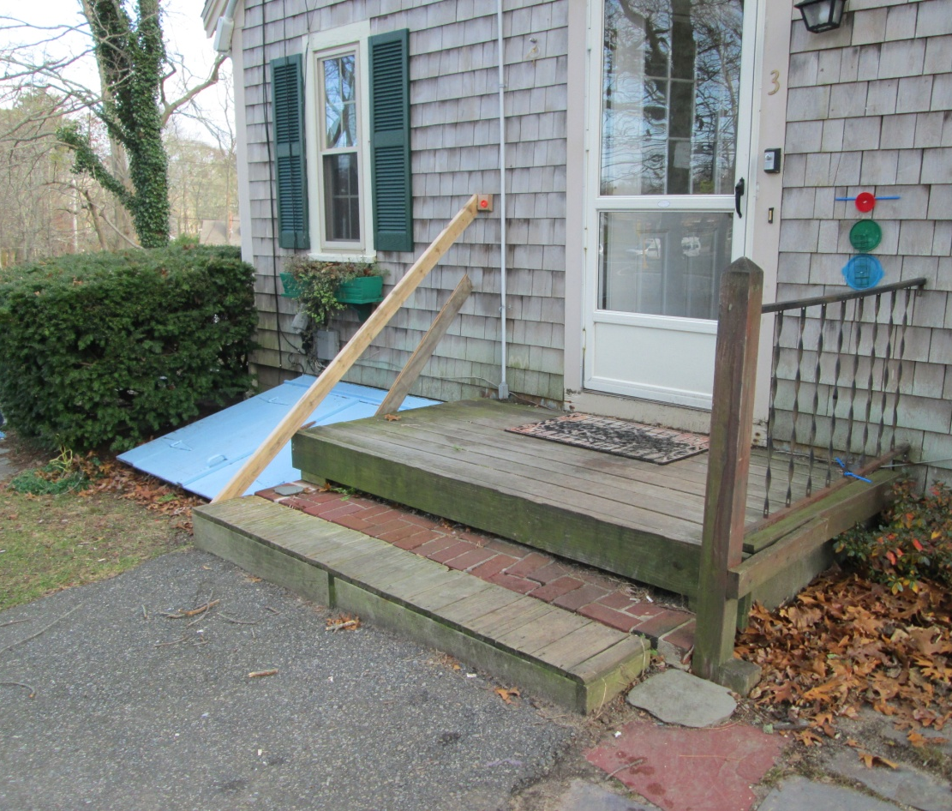
The Emmaus House Renovation
Side entrance needed up dating

Slide 7
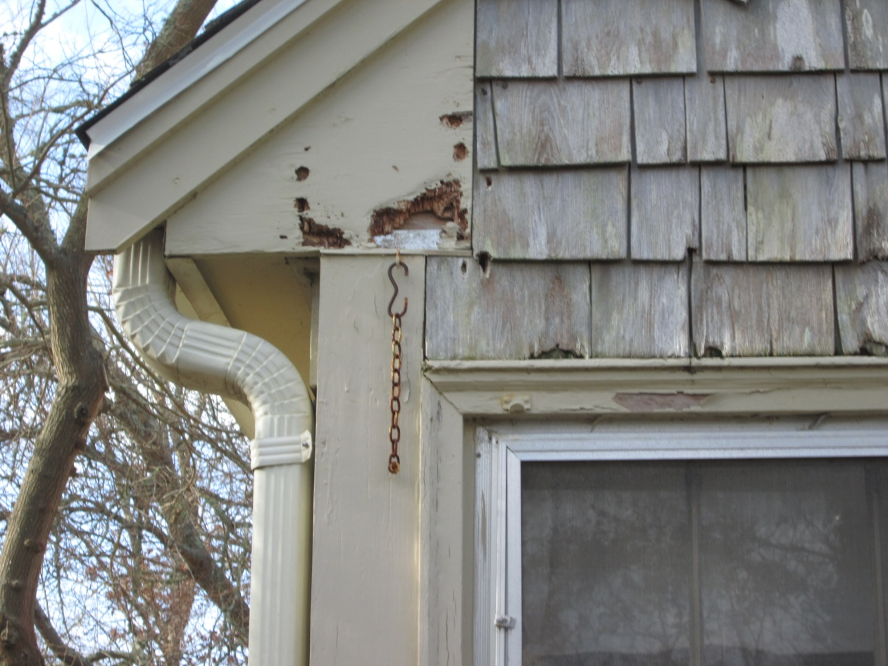
The Emmaus House Renovation
The house trim needed repair and new paint

Slide 8
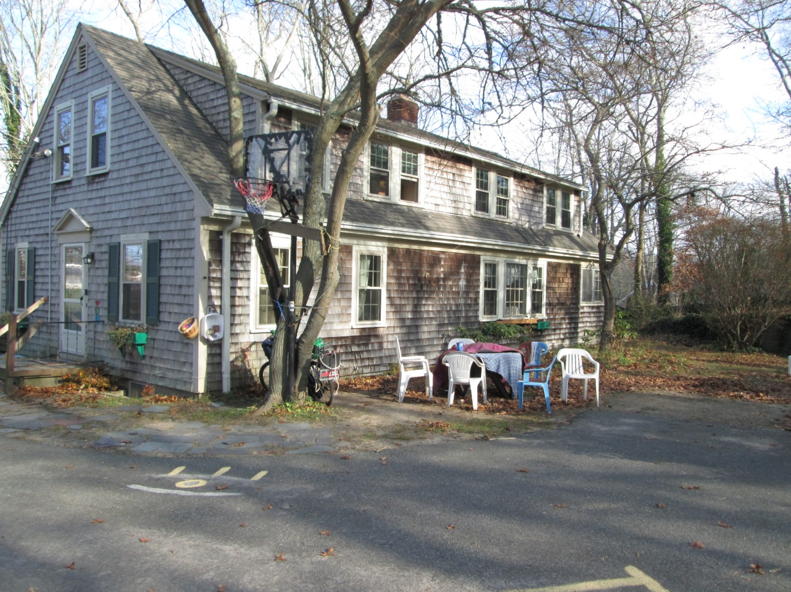
Emmaus House Renovation
Windows were inefficient and needed replacement with thermo panes

Slide 9
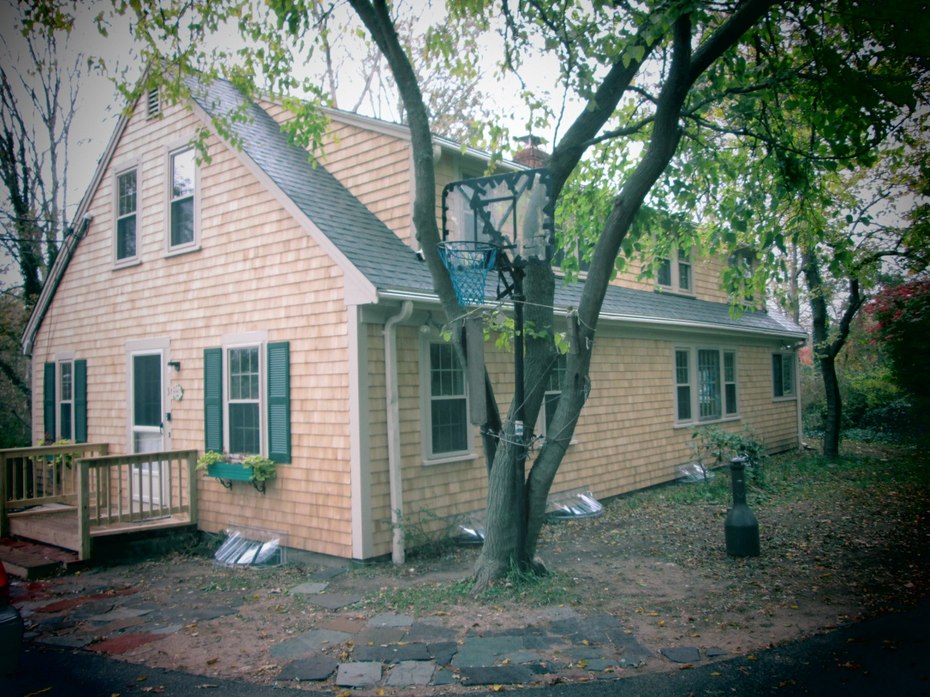
The Emmaus House
Renovation
The New Look
The outside of the house is now completely renovated, with new roof and side shingles. Note the new entrance at the side door.

Slide 10
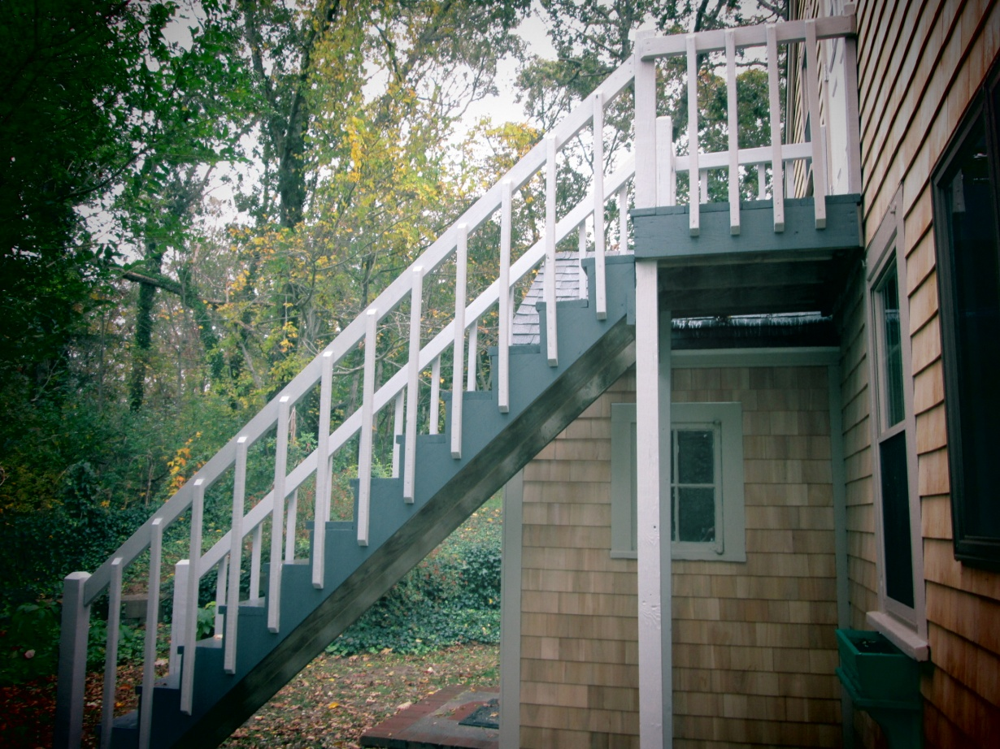
The Emmaus House Renovation
The fire escape stairs were replaced as needed and repainted.

Slide 11
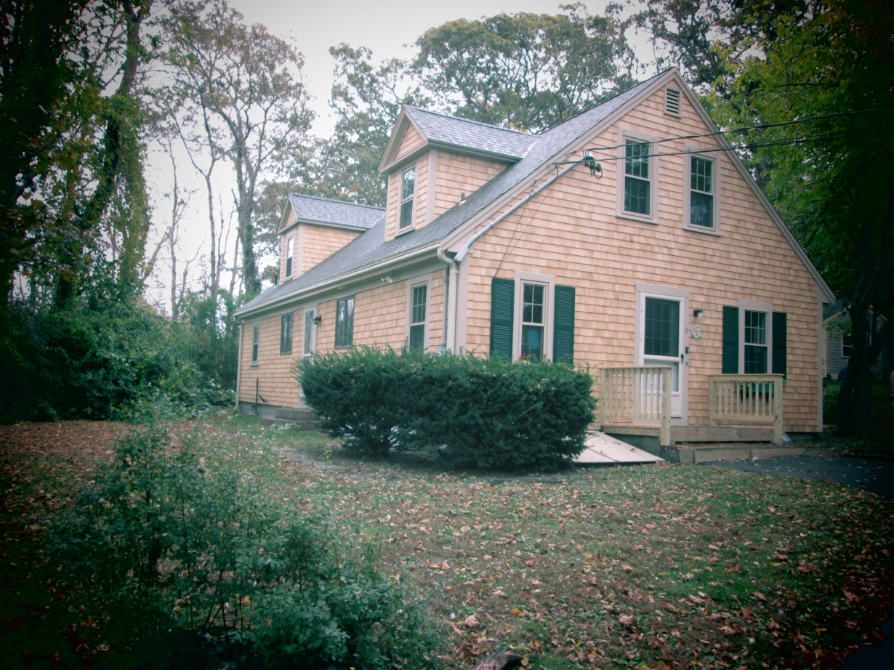
The Emmaus House Renovation
The new outside look

Slide 12
Now …… let us look at the inside of the house before the renovation………

Slide 13
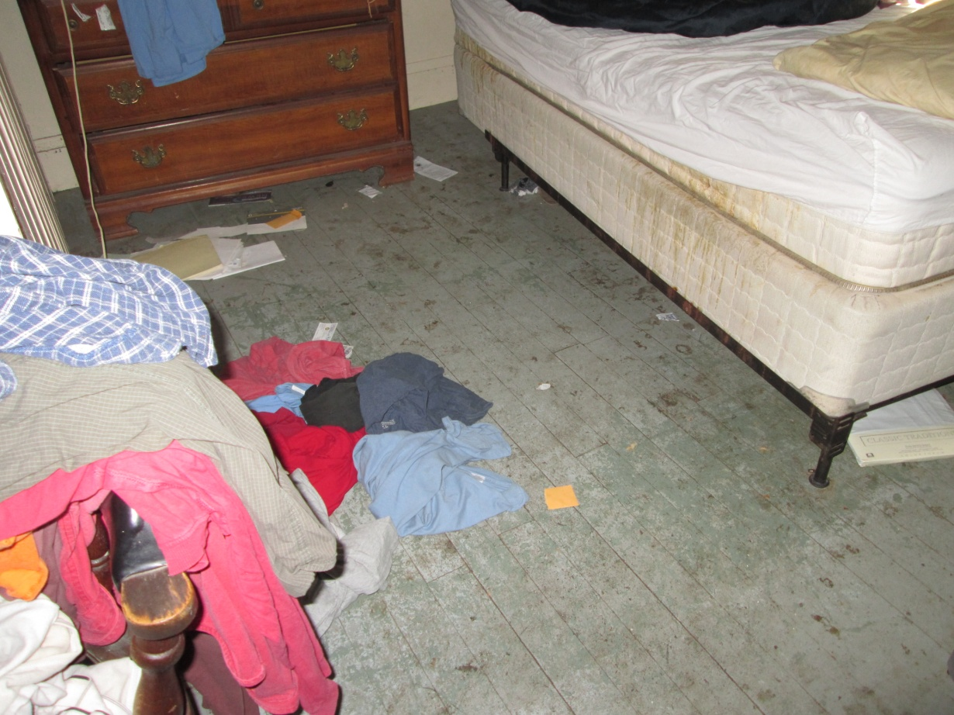
The Emmaus House Renovation
The inside of the house had deteriorated throughout the years and need complete overhaul

Slide 14
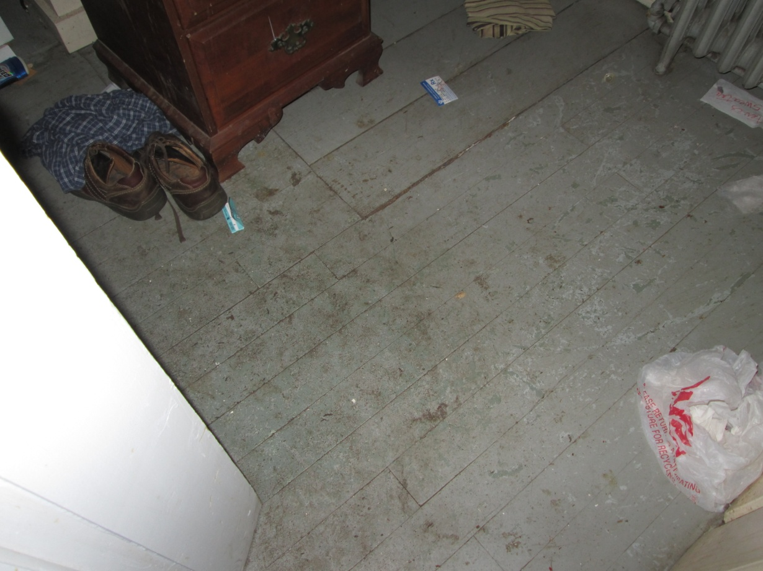
The Emmaus House Renovation
Inside …… the floors needed re finishing

Slide 15
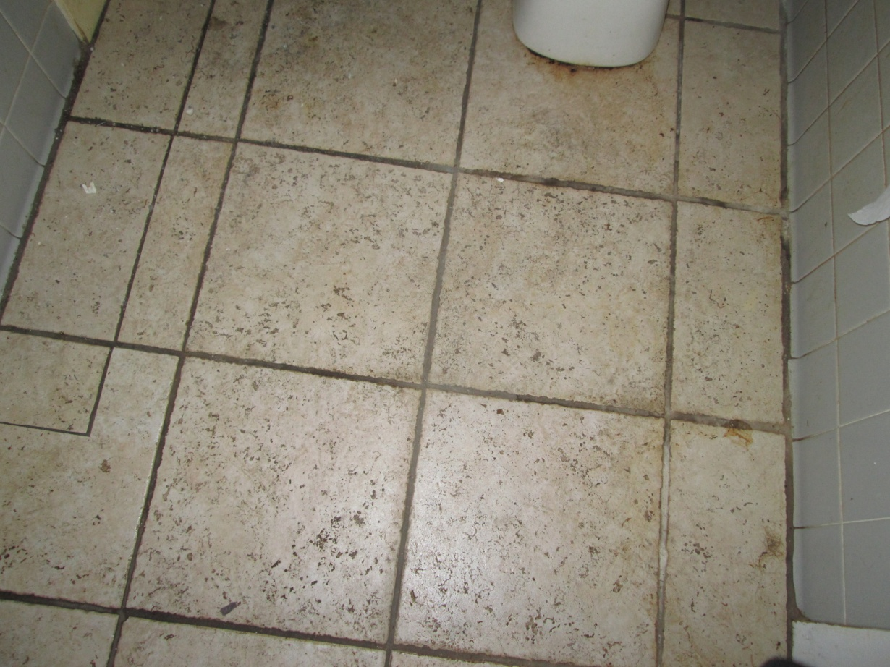
The Emmaus House Renovation
All floors were in bad condition

Slide 16
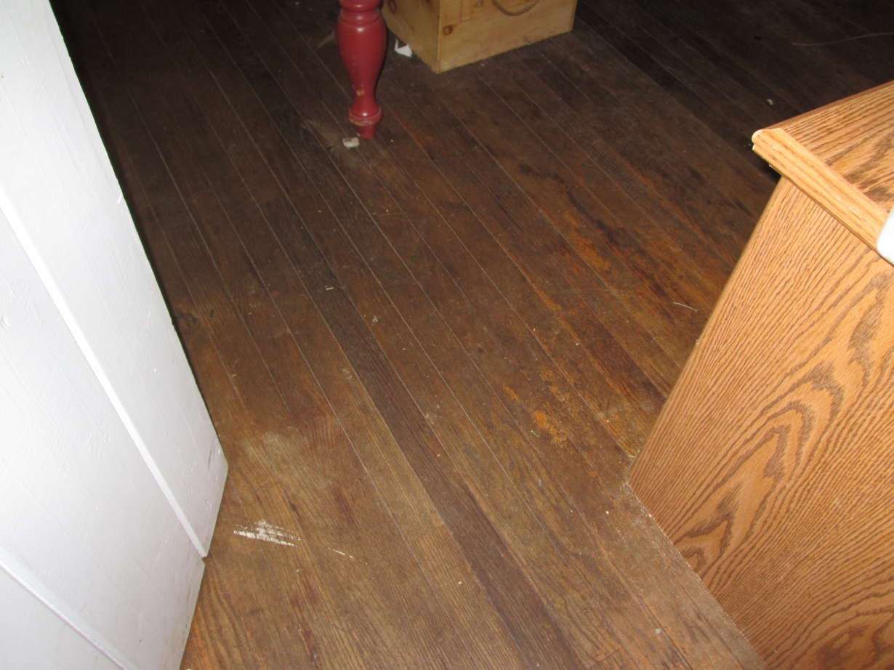
The Emmaus House Renovation
Wooden floors were scratched and pitted

Slide 17
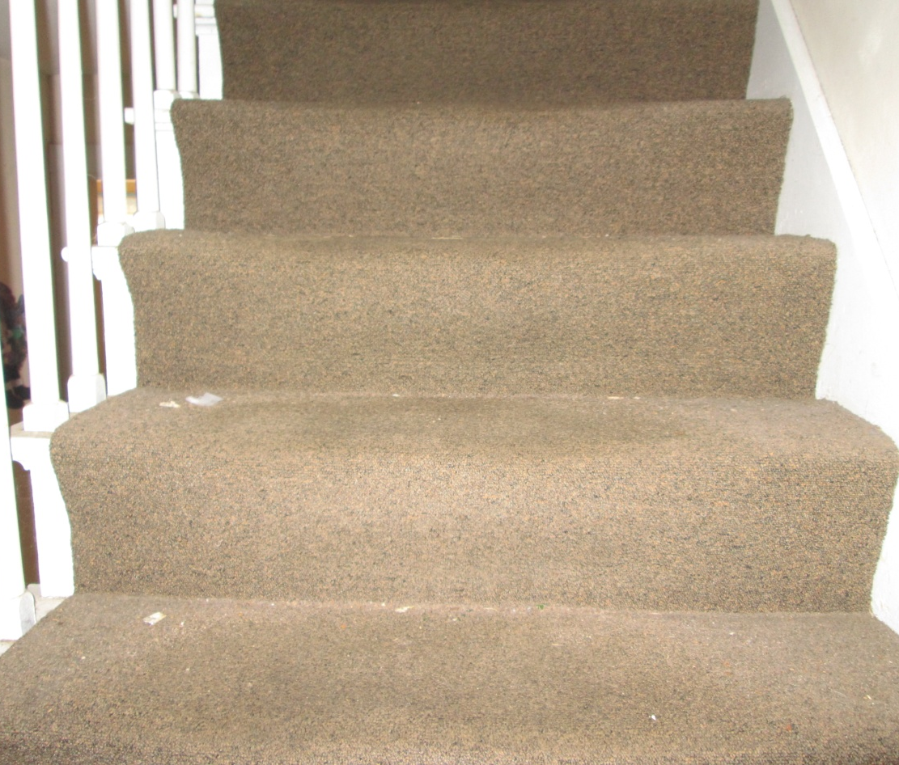
The Emmaus House Renovation
All carpets were soiled and worn

Slide 18
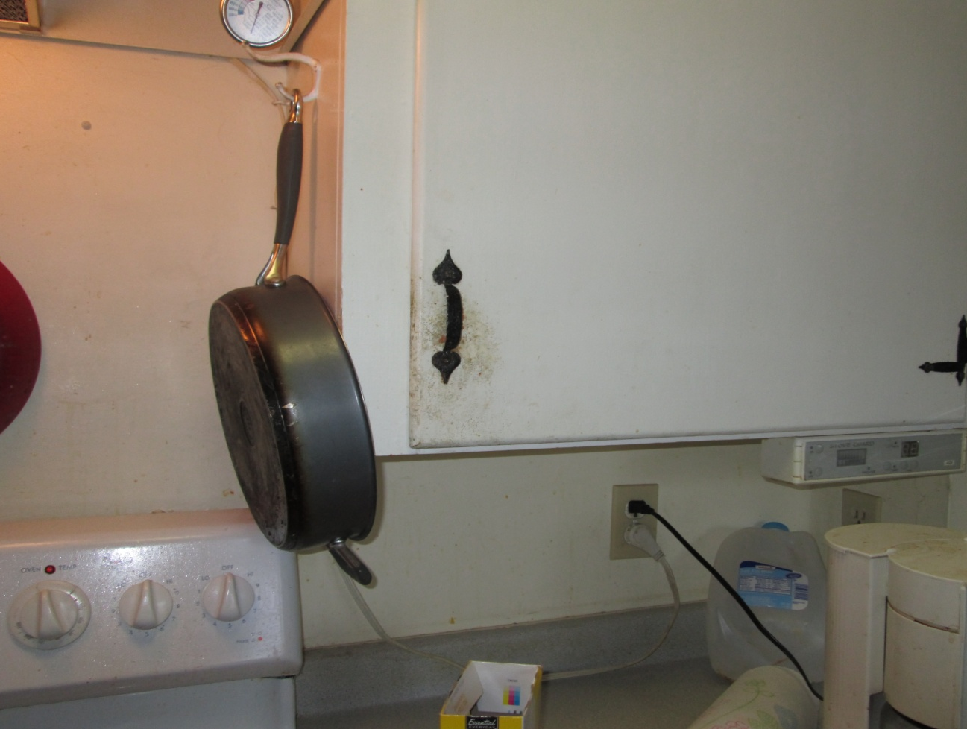
The Emmaus House Restoration
Kitchen Cabinets were soiled

Slide 19
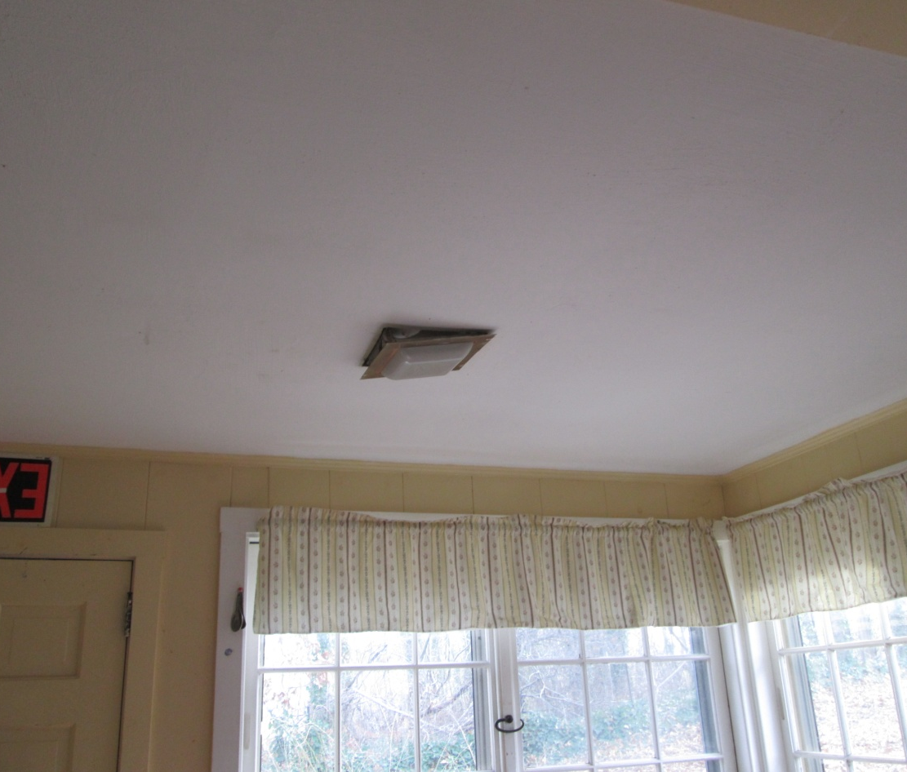
The Emmaus House Renovation
Electric fixtures had to be replaced

Slide 20
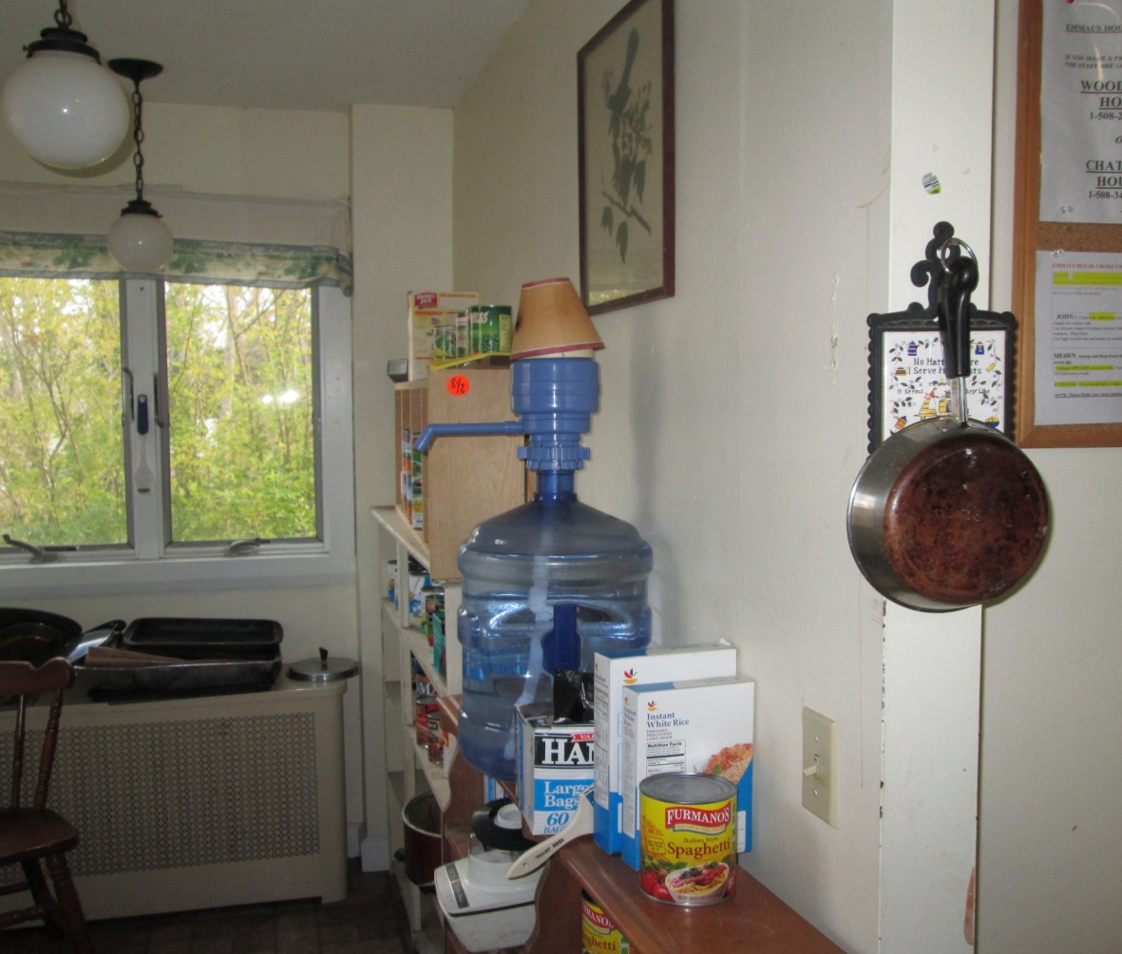
The Emmaus House Restoration
Kitchen clutter due to lack of cupboards and counter space

Slide 21
The inside of the house needed to be renovated throughout Here are some examples of how it looks now………

Slide 22
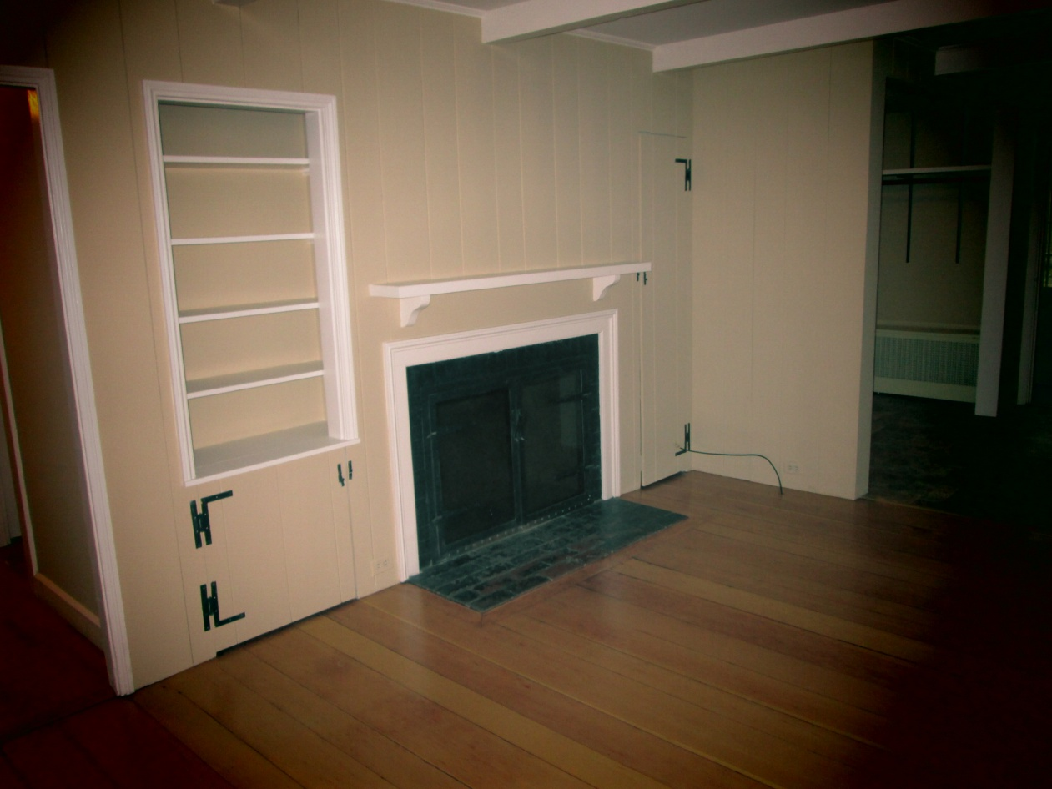
The New Look Inside
The inside of the house was completely refinished from top to bottom

Slide 23
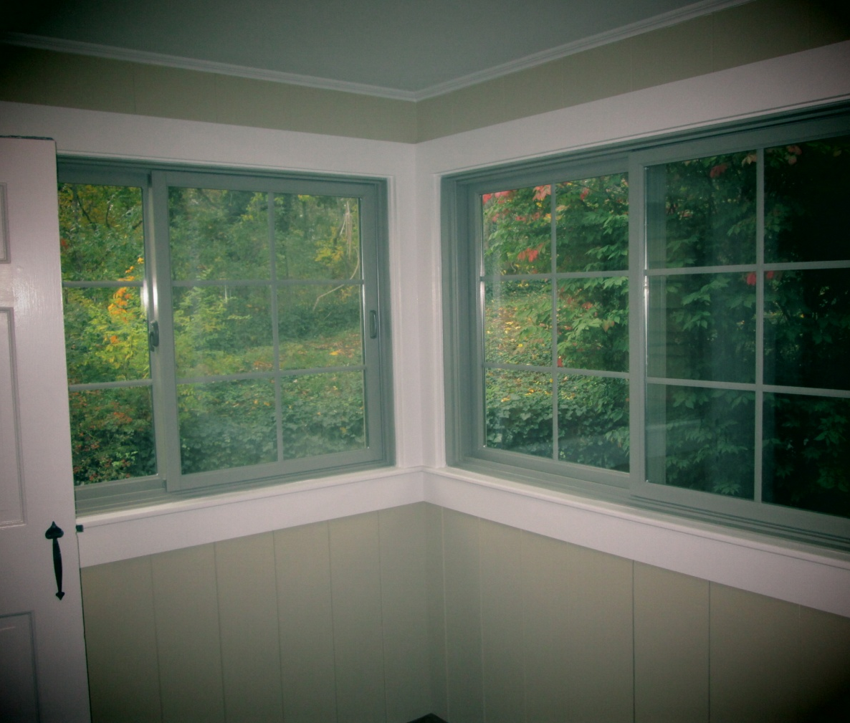
The Emmaus House Renovation
Inside completely painted. New windows and a tiled floor

Slide 24
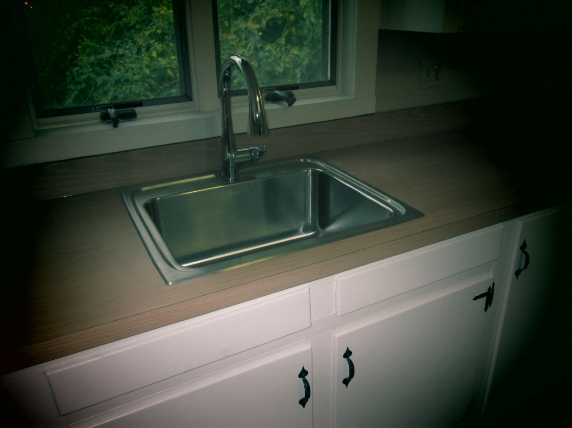
The Emmaus House Restoration
New Kitchen Counters and Sink

Slide 25
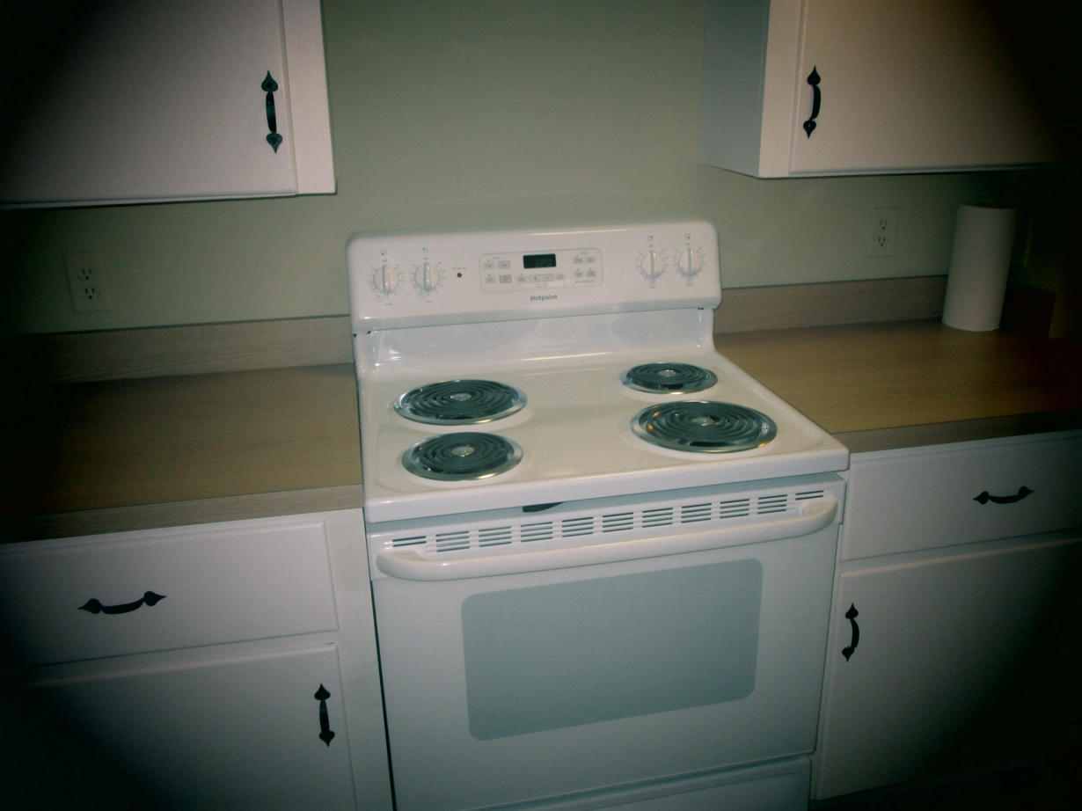
The Emmaus House Restoration
New Kitchen Stove and counters

Slide 26
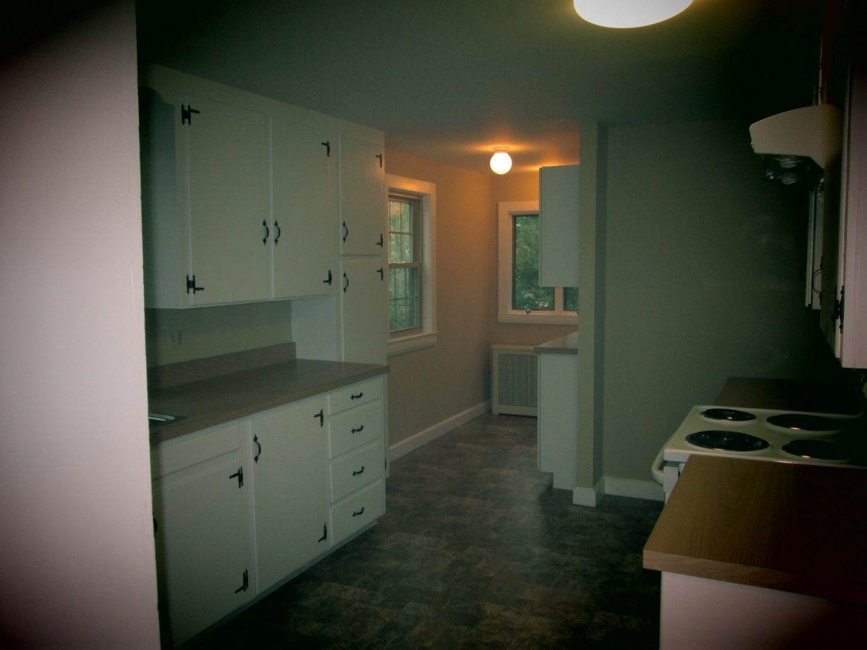
The Emmaus House Restoration
Kitchen looks like new with additional cupboards, new counters, new tiled floor, new stove and fan

Slide 27
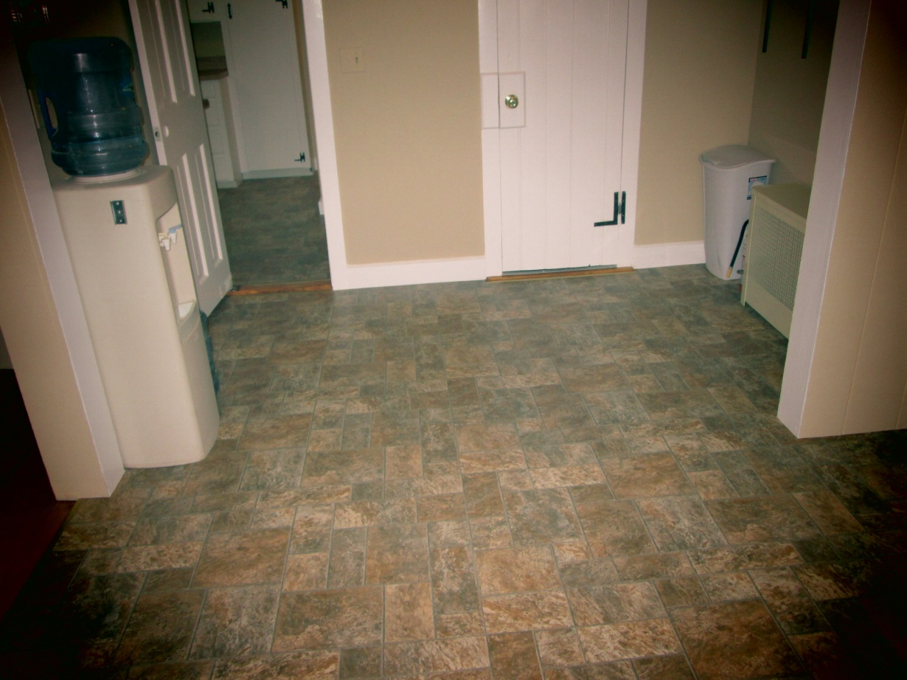
The Emmaus House Restoration
New tiled floor

Slide 28
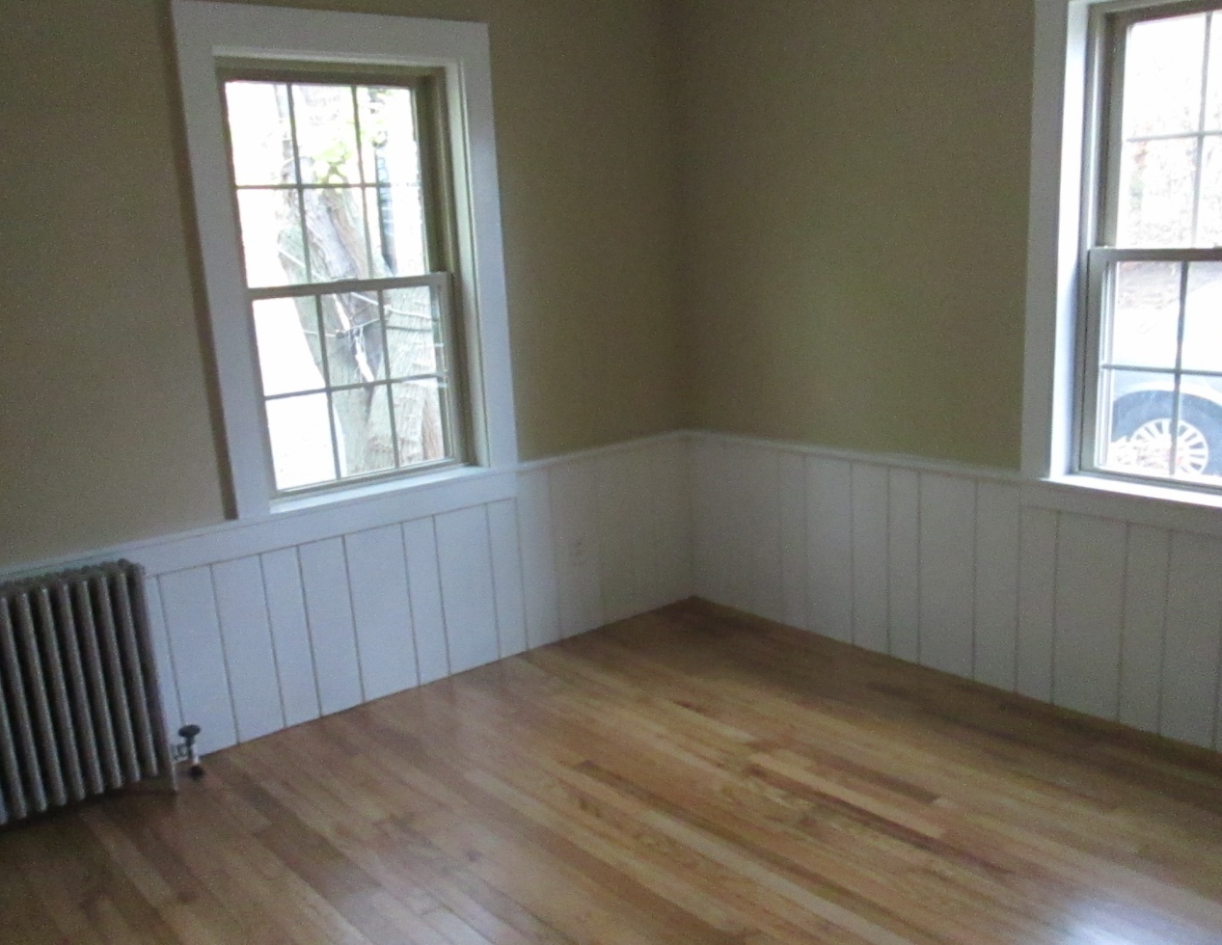
The Emmaus House Renovation
All bedrooms painted and floors sanded and finished

Slide 29
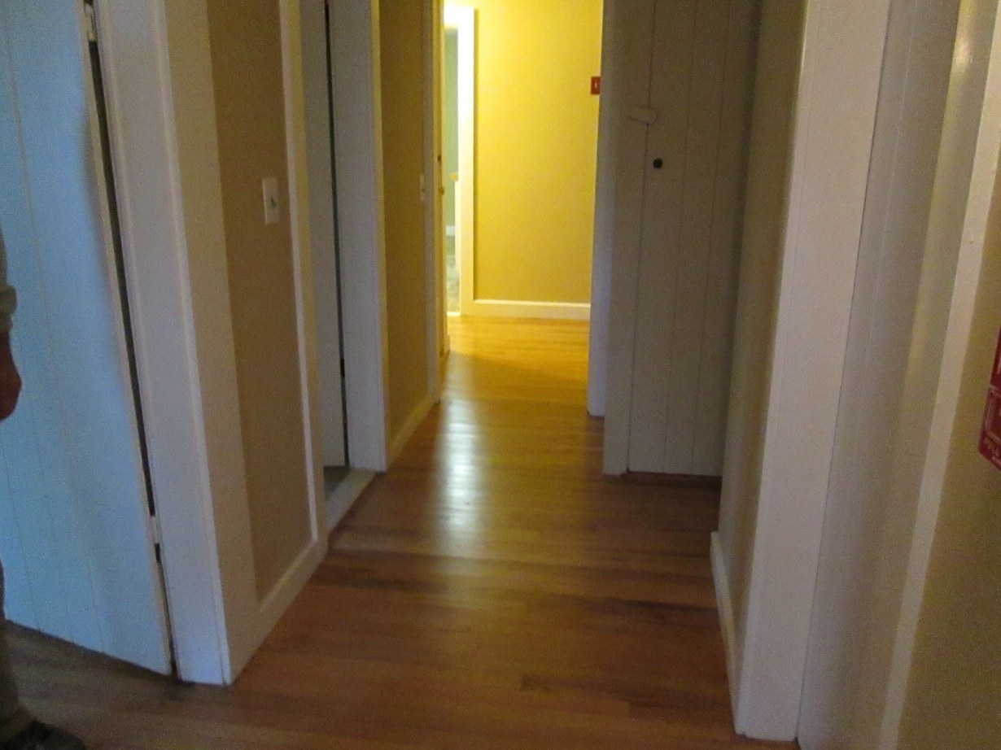
The Emmaus House Restoration
All corridor floors sanded and finished

Slide 30
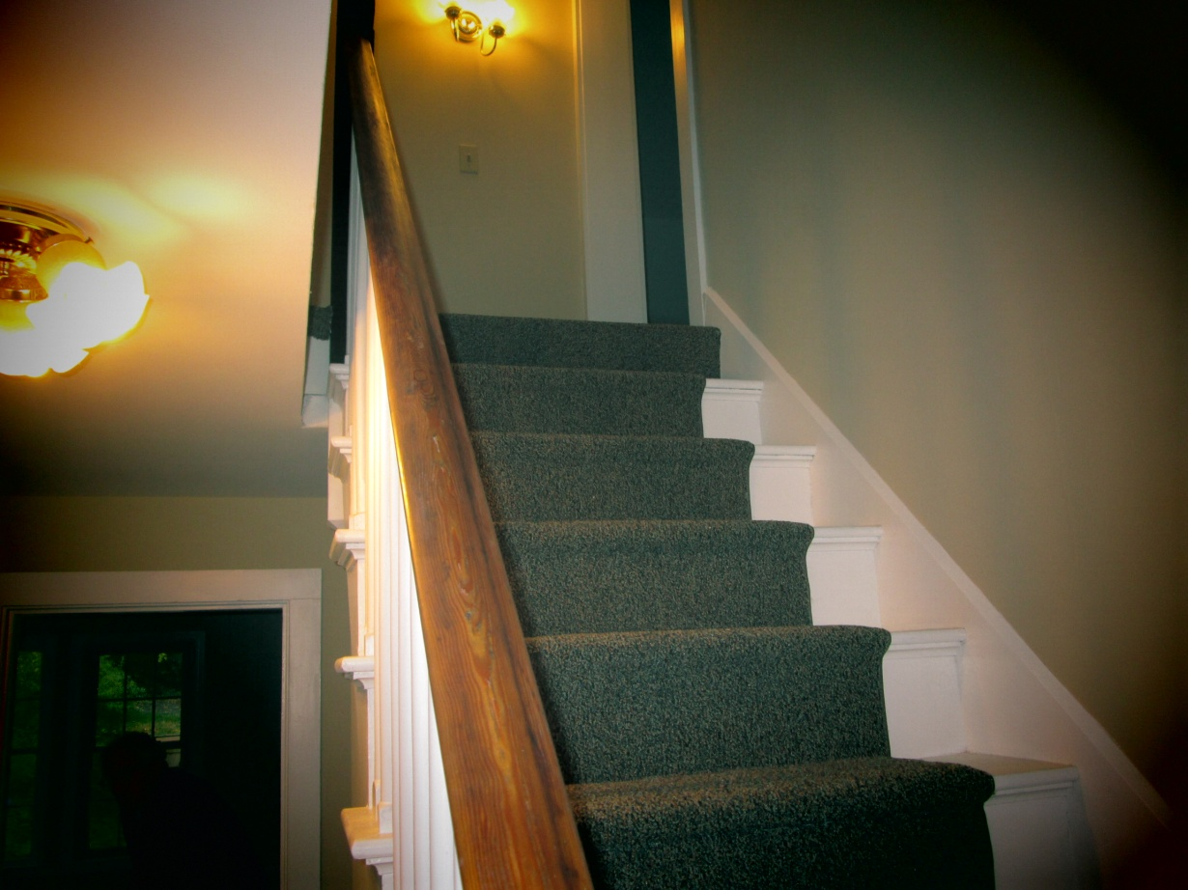
The Emmaus House Restoration
Staircase with new carpet and paint

Slide 31
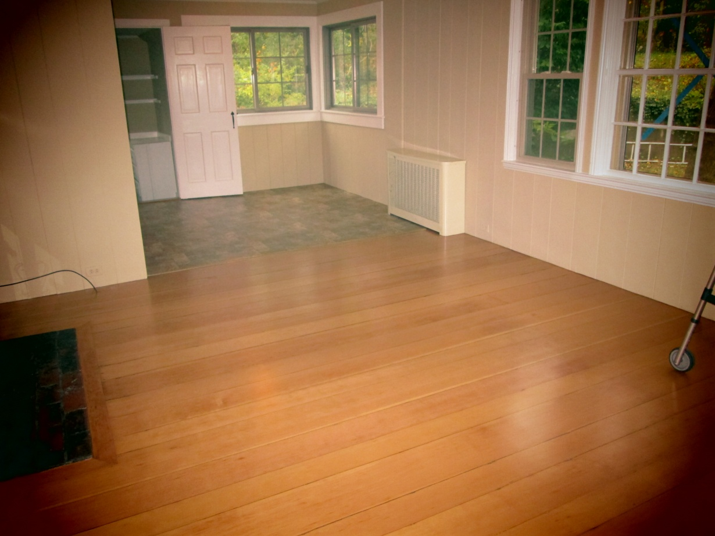
The Emmaus House Restoration
The living room with finished floor and new windows

Slide 32
The Emmaus House Restoration
The Restoration is now complete resulting in a house that looks like new

Slide 33
The Federated Church wishes to thank the
Affordable Housing Committee and the
Community Preservation Committee for their generous support.

